Slide 1

Different perspectives in Healthcare Delivery
Week 4
An Exploration of Global, National and Local Perspectives In Health Care delivery

Slide 2
Aim:
To explore the Global, National and Local Perspectives In Health Care delivery.
Learning Outcomes:
At the end of this session , students will be able to:
1-Explore the international and Global Perspectives Context of Health care delivery.
2-Explain the National contextual Perspectives of Health care delivery
3-Identfy the local contextual Perspectives of Health care delivery.

Slide 3
The major stakeholders in the healthcare system
The major stakeholders in the healthcare system are patients, physicians, employers, insurance companies, pharmaceutical firms and government. Insurance companies sell health coverage plans directly to patients or indirectly through employer or governmental intermediaries.
In conclusion, stakeholders play major role in ensuring successful adoption of evidence in healthcare. Their support is necessary because they provide resources, skills and knowledge required for project's implementation. Moreover, they influence the opinion of the public in regard to projected change.
Some examples of key stakeholders in health and social care are Inspecting bodies, Managers, employees / staff, government (and its agencies), owners of care services, owners of local businesses , suppliers (Pharmaceutical / Care) , trade unions, service users, and the community from which the organisation serves.

Slide 4
LO1-Activity- Video Presentation. 10 mins
Identify The major challenges Facing Global Health care
https://youtu.be/6Q4Ivj47jLw
Feedback To The Class

Slide 5
Global perspective Of Health care delivery
A global perspective is a comprehensive lens through which you see the world around you. It shapes how you perceive and understand your own identity and the identity of people you interact with, as you begin to understand what goes into shaping culture.
What is a global health perspective in nursing? It is the understanding that health and wellness issues transcend geographical and national borders; it is cultural competence and consciousness – having empathy, respect, and understanding of diverse populations; it is the drive to work together toward health equity.
Global health is focussed on people across the whole planet rather than the concerns of particular nations. Global health recognises that health is determined by problems, issues and concerns that transcend national boundaries.

Slide 6
Cont.…
(Koplan et al.,2009) define global health as: 'an area for study, research, and practice that places a priority on improving health and achieving health equity for all people worldwide'. ... Global health recognises that health is determined by problems, issues and concerns that transcend national boundaries’.
Many healthcare challenges are interconnected and will require a coordinated international effort to overcome.
doi: 10.3402/gha.v3i0.5142

Slide 7

A global perspective on Public health.
The five trends that are pushing the world towards a convergence of common purpose in public health:
Lower birth rates and longer lives in most countries, and a reshaping of disease patterns from infectious to chronic;
The health consequences of globalized economies, including unhealthier lifestyles and the need for international disease-control.
Environmental threats from pollution and climate change;
Internationalization of medical knowledge and the globalization of the health care workforce;
The globalization of medical science.

Slide 8

Global Health Care….
How we handle these five trends will do much to determine the quality of health and health services in the world in the coming decades.
They compare the global health perspective to the environmental movement’s concept that local actions have global impact.
“Although the individual patient encounter is a local event, and global health institutions may constitute a patchwork of entities, each patient encounter takes place in a global tapestry of influences that constitute ‘global public health.’”
Read NEJM editorial: Convergence to Common Purpose in Global Health

Slide 9
Top global health issues
Global Health Security.
Malaria
Polio
Measles
Tuberculosis (TB)
Climate crisis
Health care delivery in areas of conflict and crisis
Environmental Quality
Global Health Security
Climate crisis
Tobacco
Substance Abuse
Covid 19
Physical Activity and Nutrition
Overweight and Obesity
Tobacco
Substance Abuse
HIV/AIDS
Mental Health
Injury and Violence
Infectious disease prevention
Overweight and Obesity
Neglected Tropical Diseases

Slide 10

Impact of Covid 19 on Global Healthcare Perspective
Coronavirus—now officially known as COVID-19—likely won’t be as disastrous as that particular prediction, but there have been 45,171 confirmed cases globally across two dozen countries, and 1,115 people have died. It has global health officials very concerned about just how prepared we are for this or any other pandemic. On January 31, 2020, the World Health Organization declared the outbreak a Public Health Emergency of International Concern.

Slide 11
Impact of Covid 19 on Global Healthcare Perspective- Cont.…
2020 was a devastating year for global health. A previously unknown virus raced around the world, rapidly emerging as one of its top killers, laying bare the inadequacies of health systems. Today, health services in all regions are struggling to both tackle COVID-19 and provide people with vital care.
The COVID-19 pandemic has exposed vulnerabilities even in health systems that had been considered strong, such as those in Spain and Italy. Around the world, the pandemic has also highlighted the indelible link between citizens’ health and the strength of economies.

Slide 12

Cont.…
In another blow, the pandemic threatens to set back hard-won global health progress achieved over the past two decades - in fighting infectious diseases, for example, and improving maternal and child health.
So in 2021, countries around the world will need to continue battle COVID-19 (albeit with the knowledge that effective tools are evolving).
They will need to move swiftly to repair and reinforce their health systems so they can deliver these tools, and to address the key societal and environmental issues that result in some sections of the population suffering so much more than others.

Slide 13
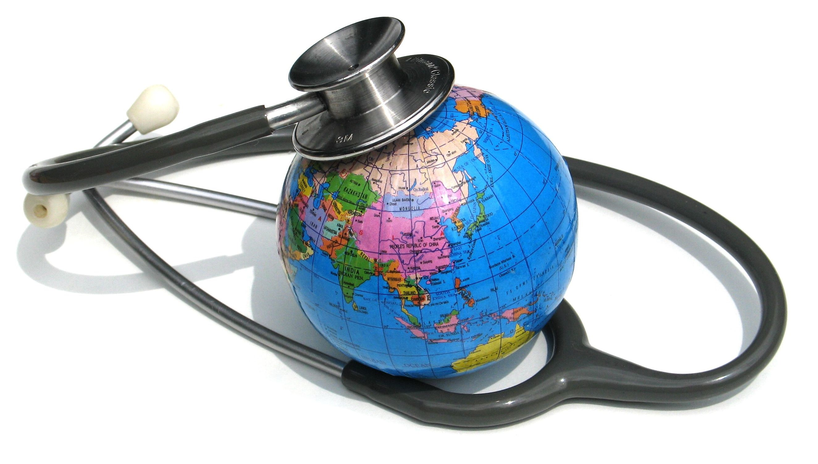
Impact of Covid 19 on Global Healthcare Perspective- World Health Organization (WHO)
WHO will work with countries to improve their own preparedness for pandemics and health emergencies. But for this to be effective, we will ensure that countries work together. Above all, this pandemic has shown us over and again, that no one is safe until everyone is safe.
We will also help tackle health emergencies in humanitarian settings that have been intensified by COVID-19. We will target support to better protect the most vulnerable communities against health emergency risks, including in urban settings, small island countries, conflict settings.
We will leverage existing partnerships and create new ones to build a global health emergencies workforce to expand, train and standardize high-quality public health and medical assistance.
We also plan to establish a Bio Bank – a globally agreed system for sharing pathogen materials and clinical samples to facilitate the rapid development of safe and effective vaccines and medicines. And we will sustain our focus on getting accurate information to people, building on our work with key partners to protect populations from infodemics.
WHO and its partners will be at their side. We will work to help countries strengthen preparedness for pandemics and other emergencies. We will remind them of the importance of bringing countries together and of involving the whole government, not just the health sector. And we will support them in building strong health systems and healthy populations.

Slide 14
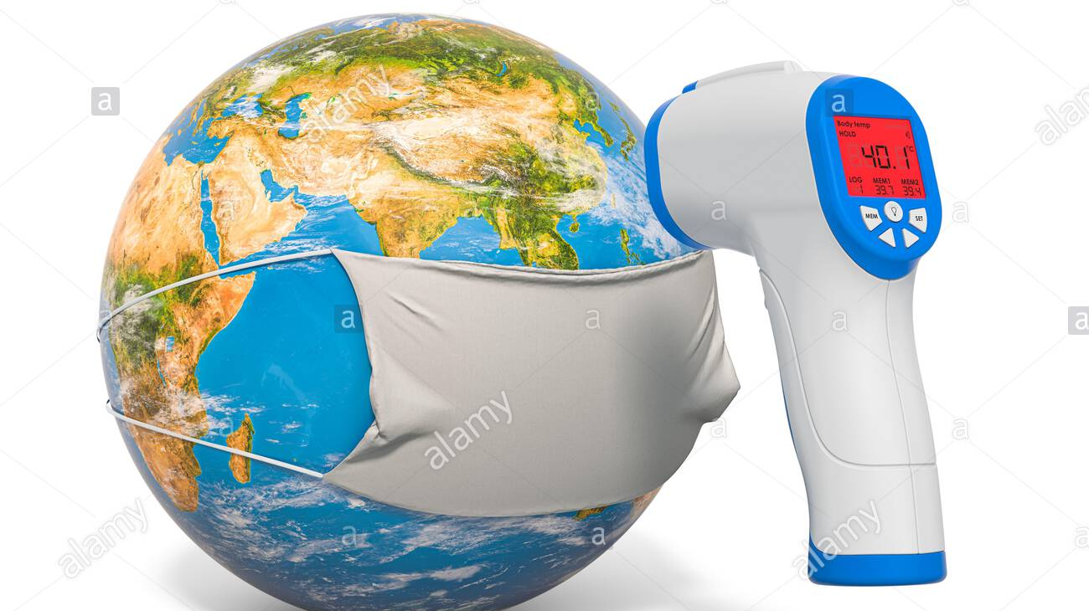
Current World Health Organization Priorities for COVID-19
Current World Health Organization priorities call for infrastructures capable of detecting, monitoring, and responding to health emergencies, such as COVID-19, and the health impacts of climate change in the context of health for all.
Health care infrastructure can be better prepared and more equitable if systems are strengthened by building on core competencies and following the recommendations made for leadership, stakeholder involvement, accreditation, data collection, and funding resources.
Ensuring health equity in a pandemic requires robust and resilient public health infrastructure during normal times.

Slide 15
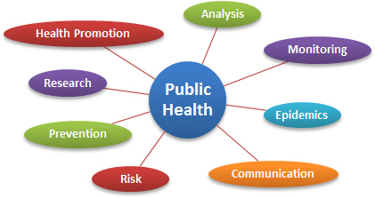
LO2-Activity -10mins-Public Health England
Conduct an individual research into the Roles of Public health England.
Feedback To the class.
This video provides an explanation of what public health is. You can also find out more about the history of public health, and the meaning of some useful public health terms.
https://youtu.be/oy1CAMObRzc

Slide 16
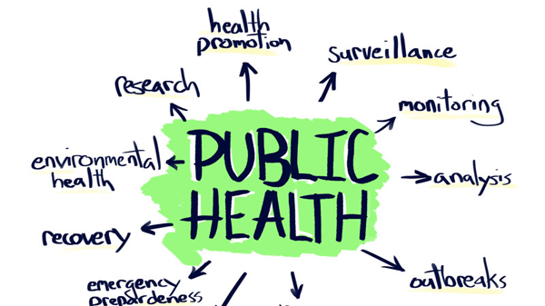
National perspective of Health care delivery
Public Health England
Public Health England is an executive agency of the Department of Health and Social Care in the United Kingdom that began operating on 1 April 2013. Its formation came as a result of the re-organisation of the National Health Service in England outlined in the Health and Social Care Act 2012. We exist to protect and improve the nation's health and wellbeing and reduce health inequalities.
Public Health England is the national agency for protecting and improving the nation’s health and wellbeing and tackling health inequalities so that the poorest and most poorly benefit most.
PHE will provide professional, scientific and delivery expertise to support both local authorities and NHS organizations to promote improvements in protecting and improving the nation’s health and wellbeing.
Public health are responsible for making the public healthier and reducing differences between the health of different groups by promoting healthier lifestyles, advising government and supporting action by local government, the NHS and the public. protecting the nation from public health hazards.
PHE is an executive agency sponsored by the Department of Health and Social Care.

Slide 17

Main roles of Public Health England
Making the public healthier and reducing differences between the health of different groups by promoting healthier lifestyles, advising government and supporting action by local government, the NHS and the public.
Protecting the nation from public health hazards
When commissioning clinical services such as sexual health and drug and alcohol services ensure that providers have appropriate clinical governance arrangements in place that are equivalent to NHS standards.
Preparing for and responding to public health emergencies
Improving the health of the whole population by sharing our information and expertise, and identifying and preparing for future public health challenges
supporting local authorities and the NHS to plan and provide health and social care services such as immunisation and screening programmes, and to develop the public health system and its specialist workforce
Researching, collecting and analysing data to improve our understanding of public health challenges, and come up with answers to public health problems.

Slide 18
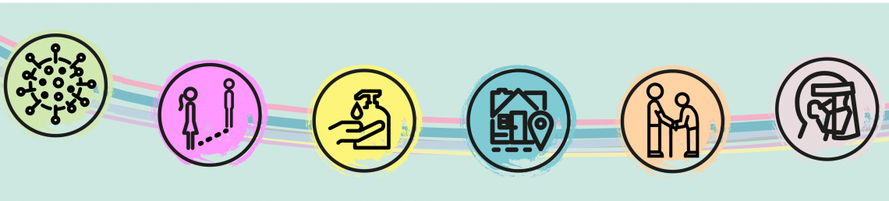
Impact of Covid- 19 on National Healthcare Perspective- (PHE)
Directors of public health have a critical role in responding to the Covid-19 pandemic. Their knowledge and expertise in population health, training and responsibility in infectious disease control are vital in addressing its immediate impacts on the health of their local populations (as well as the economic impacts of the pandemic and its aftermath).
Their understanding of local places and resources, such as contact tracing, and their broader role in local government situate them at the Centre of local decision-making that affects public health.
https://www.kingsfund.org.uk/projects/covid-19-and-public-health-system

Slide 19
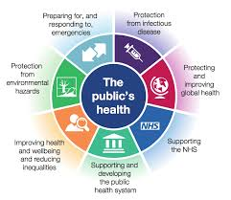
Impact of Covid 19 on Public Health England
The COVID-19 pandemic has significantly stressed public health systems around the world and exposed the gaps in health care for underserved and vulnerable populations.
In the context of the social determinants of health, focusing on health system preparedness is paramount for protecting the health of all of society.
Faced with old threats (e.g., re-emergence of measles), disruptive new technologies (e.g., electronic cigarettes), increased challenges (e.g. drug-resistant organisms), and new threats (e.g., the current pandemic, climate change, politicized misinformation), our health systems must be robust and resilient.

Slide 20
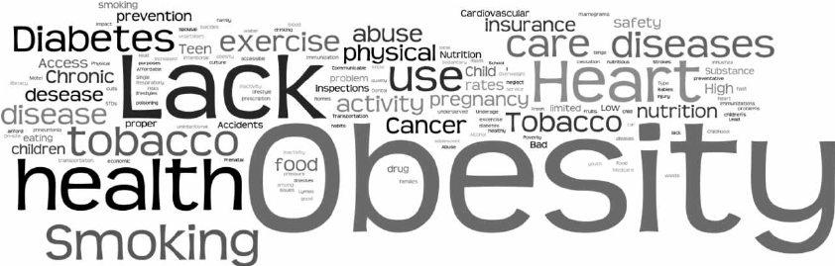
What are public health issues in UK?
Covid 19
Rough sleeping.
Air pollution.
Alcohol.
Bowel cancer.
Cardiovascular disease prevention.
Cervical screening.
Child dental health
(Click the below link for more public health issues)
www.gov.uk › government › collections › health-matters-public-health-i
Health matters: public health issues - GOV.UK

Slide 21

National Health Service (NHS)
A comprehensive public-health service under government administration, established by the National Health Service Act of 1946 and subsequent legislation. Virtually the entire population is covered, and health services are free except for certain minor charges.
The services provided are administered in three separate groups: general practitioner and dental services, hospital and specialist services, and local health authority services. General practitioners or family physicians give primary medical care to a group of persons who register with them.
These doctors and dentists operate their own practices but are paid by the government on a per capita basis (i.e., according to the number of people registered with them)
The National Health Service is financed primarily by general taxes, with smaller contributions coming from local taxes, payroll contributions, and patient fees. The service has managed to provide generally high levels of health care while keeping costs relatively low, but the system has come under increasing financial strain because the growth of medical technology has tended to make hospital stays progressively more expensive.

Slide 22
The roles of the NHS in public health improvement
Prevention of major risk factors like smoking and alcohol, and using screening to make earlier diagnoses. The NHS can also help to tackle more complex issues like multi-morbidity, and be part of interventions that address people’s social context and underlying causes of ill health (e.g. poor housing, unemployment or poor working conditions).
By acting as a role model employer providing good quality, stable employment and prioritising the health and wellbeing of its workforce, creating healthy and environmentally sustainable environments for both patients and staff
Work more widely with wider partners to foster joint commissioning where appropriate and to inform wider strategies, for example around adult social care, children’s services, transport, housing and leisure
Ensure that disadvantaged groups receive the attention they need, with the aim of reducing health inequalities

Slide 23
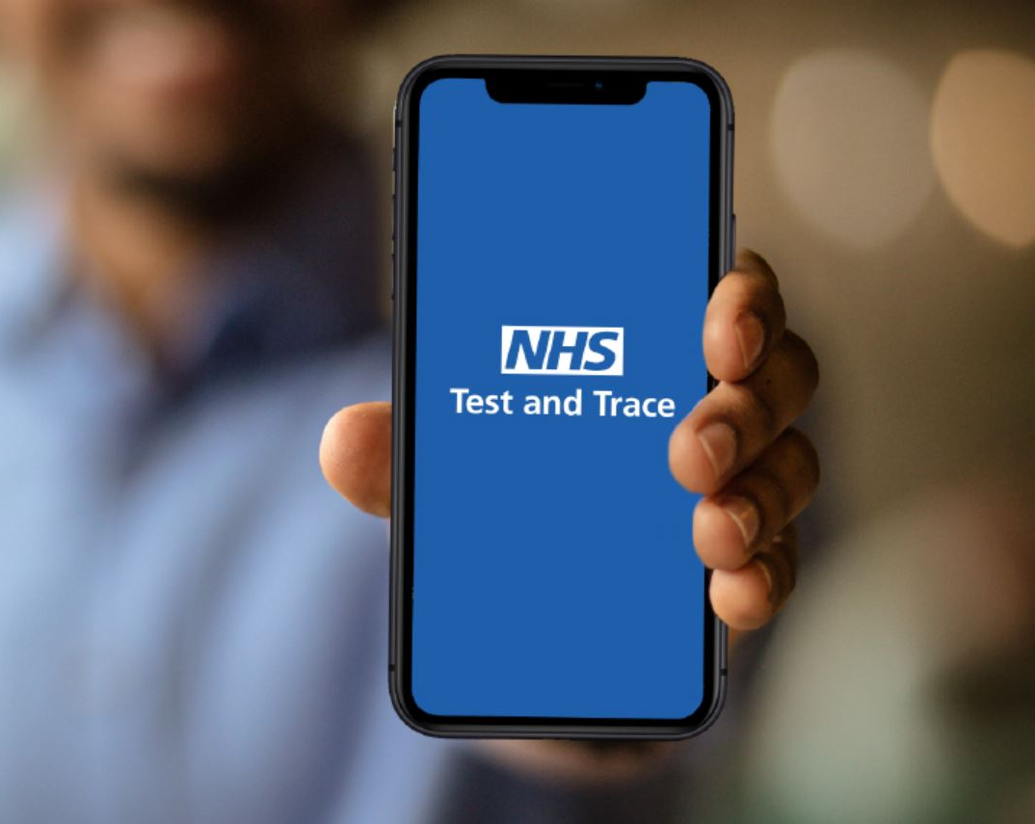
Impact of Covid 19 on National Health service (NHS)
Trace and track service:
NHS introduced the trace and track service to help return life more to normal, in a way that is safe and protects our NHS and social care. The service will allow us to trace the spread of the virus and isolate new infections and play a vital role in giving us early warning if the virus is increasing again, locally or nationally.
Some local authorities have their own contact tracing teams who are employed by the local council. NHS Test and Trace may pass your details to these local teams if you have tested positive for coronavirus and they have not been able to contact you for 24 hours.
These teams work with local public health experts and will usually contact you by phone and text. In certain circumstances they may visit you at your home to ask you to make further contact with them or to ask about your contacts.

Slide 24
Care Quality Care (CQC)
The CQC is a non-departmental statutory body, sponsored by the Department of Health, responsible for regulating health and social care services in England, as well as protecting the interests of people whose rights are restricted under the Mental Health Act 1983 (MeHa 1983).
The Care Quality Commission (CQC) regulates all health and social care services in England. The commission ensures the quality and safety of care in hospitals, dentists, ambulances, and care homes, and the care given in people’s own homes.
Role of CQC
Our role is to monitor, inspect and regulate services to make sure they meet the fundamental standards of quality and safety. For safeguarding, we will do this by: Checking that care providers have effective systems and processes to help keep children and adults safe from abuse and neglect.
Who do the Care Quality Commission regulate?
CQC is the independent regulator of healthcare and adult social care services in England. We make sure the care provided by hospitals, dentists, ambulances, care homes and home-care agencies meets government standards of quality and safety.

Slide 25

Medicines & Healthcare products Regulatory Agency
The MHRA is working closely with DHSC and other healthcare partners on COVID-19.
We are prioritising work including:
supporting and authorising the development of vaccines
clinical trials of new medicines
managing the supply of medicines and healthcare products
We also provide information to patients, manufacturers and healthcare professionals through our established information channels and alert systems.

Slide 26
Partnership in public health strategy
National government is responsible for national strategy, legislation and policy on the public’s health and other decisions that influence the wider determinants of health
Local government responsible for improving the health of people within their area
NHS responsible for supporting people to live more healthily and delivering health improvement interventions
The public make choices around their lives and health
Voluntary and community sector influence public health by providing people with voluntary opportunities
PHE protects the country from threats to health, including outbreaks of infectious diseases, improves the public’s health and wellbeing.
Industry influences public health by providing people with employment, goods, services, and information
Global public health collaborating internationally to identify and address threats to health.
Scientific and academic community apply scientific knowledge, methods for the prevention of disease

Slide 27

Department of Health England
The Department of Health (DOH) is the country's principal health agency. It is responsible for ensuring access to basic public health services through the provision of quality healthcare and the regulation of providers of health goods and services.
What are the three roles of Department of Health?
The mission of the National Department of Health is to improve health status through the prevention of illness, disease and the promotion of healthy lifestyles, and to consistently improve the health care delivery system by focusing on access, equity, efficiency, quality and sustainability.

Slide 28
Glossary of different health care Perspectives
BMA: British Medical Association
CCG: Clinical Commissioning Groups
DCN: District Councils Network
DPH: Director of Public Health
GP: General Practitioner
HWB(s): Health and Wellbeing Board(s)
JSNA: Joint Strategic Needs Assessment
JHWS: Joint Health and Wellbeing Strategy
RCN: Royal College of Nursing
LSHTM: London School of Hygiene and Tropical Medicine
NHSE: NHS England
PCT: Primary Care Trust
PHE: Public Health England
PHOF: Public Health Outcomes Framework
PRUComm: Policy Research Unit in Commissioning and the Health Care System
UKFPH: UK Faculty of Public Health

Slide 29
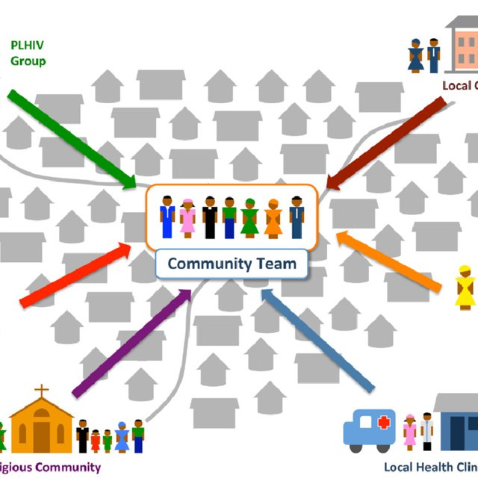
LO3-Actvity Class Discussion
Video activity (20 minutes)
Identify the local contextual Perspectives of Health care delivery.
https://youtu.be/7VsGoUWsfuI
Working in pairs/ small group, with extracts from the video clips
from the above video link,
Identify ways to support local health improvement activities
Feedback to the class
.

Slide 30
Local health improvement role in public health
Providing information and advice
Providing services or facilities designed to promote healthy living
Providing services or facilities for the prevention, diagnosis or treatment of illness
Providing assistance to help individuals to minimise any risks to health arising from their accommodation or environment
Making any other services or facilities available.
responsible for organizing, planning, and monitoring the timely provision of appropriate health care services, including arrangements for all levels of health care and the ensuring of quality and accessibility of all health services

Slide 31
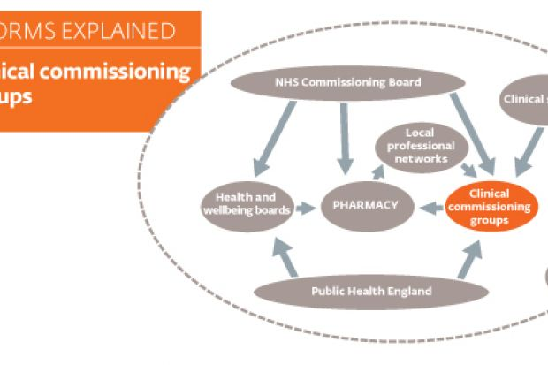
Local Perspectives of Health care delivery
Local authorities have, since 1 April 2013, been responsible for improving the health of their local population and for public health services including most sexual health services and services aimed at reducing drug and alcohol misuse
Local health authority services provide maternity and child welfare, posthospital care, home nursing, immunization, ambulance service, and various other preventive and educational services. They may also operate family-planning clinics, as well as day nurseries for children.
Clinical commissioning groups (CCGs)
Established as part of the Health and Social Care Act in 2012 and replaced Primary Care Trusts on 1 April 2013. CCGs are groups of general practices (GPs) which come together in each area to commission the best services for their patients and population.
As a result of the reforms, local authorities are now responsible for statutory public health responsibilities, aligning their responsibilities for education, employment, environment, housing and transport with public health.

Slide 32

Impact of Covid 19 on Local Healthcare
Across the country, local government continues to show the nation that councils are there for our communities in our times of greatest need.
They have had to step in to ensure supplies of personal protective equipment get through to care homes, provided advice to schools, carried out vital modelling work for hospitals and helped redeploy staff and reconfigure teams to keep vital council services running.
Local authorities’ public health role also includes ensuring that there are plans in place to protect the local population from health threats, including plans for emergencies, preventative measures such as immunisations and screening and monitoring the plans individual providers have in place.
They are also required to provide Clinical Commissioning Groups (CCGs) with population health advice, for example supporting the development of joint strategic needs assessments.

Slide 33
In conclusion, we have learnt how to:
1-Explore the international and Global Perspectives Context of Health care delivery.
2-Explain the National contextual Perspectives of Health care delivery
3-Identfy the local contextual Perspectives of Health care delivery.

Slide 34

Assessment guide
Open the assessment guide in word document

Slide 35
ASSESSMENT SUBMISSION
Date assignment set | 04/01/2021
Submission deadline date | 29/03/2021
Return date to students | 26/04/2021
All assignment will be submitted in electronic format and uploaded to LSC Portal on Turnitin

Slide 36

Reference https://www.intrahealth.org/vital/10-global-health-issues-watch-2020s. www.gov.uk › government › collections › health-matters-public-health-i... Health matters: public health issues - GOV.UK https://www.cqc.org.uk/sites/default/files/20171114_exe_procurementinfo.pdf https://www.kent.ac.uk/chss/docs/CLG-report.pdf

